Slide 1

PROJEK INOVASI
PORTABLE INTEGRATED
CHEMICAL DETECTOR
DESIGN PROPOSAL
DISEDIAKAN UNTUK: INSTITUT PENYELIDIKAN SAINS & TEKNOLOGI PERTAHANAN (STRIDE)
6hb September 2021

Slide 2
1.0 Objektif
Merekacipta alat pengesan gas mudah alih
Merekacipta pelbagai fungsi untuk operasi intuitif
Untuk merekacipta sistem yang cepat dan mudah dikendalikan dalam penggunaan seharian
1.1 Penyataan Masalah
Software yang tidak stabil
  Software berhenti berfungsi ketika proses komunikasi
  Software berhenti berfungsi ketika operasi
  Software berhenti berfungsi Ketika menyimpan data ke dalam format Excel
Hardware
  Tidak dapat berkomunikasi dengan satelit
  Bacaan sensor yang tidak stabil

Slide 3

2.0 Spesifikasi Teknikal
Master Design
MULTI PARTICLE DETECTOR
OLED DISPLAY
LORA
CARBON DIOXIDE DETECTOR
MICROCONTROLLER
1
LORA
USB CONTROLLER
GPS / GNSS
MICROCONTROLLER
2
WINDOWS MONITORING SYSTEM
BATTERY
BMS
USB CHARGE
SENSOR SYSTEM
UI MONITORING SYSTEM

Slide 4
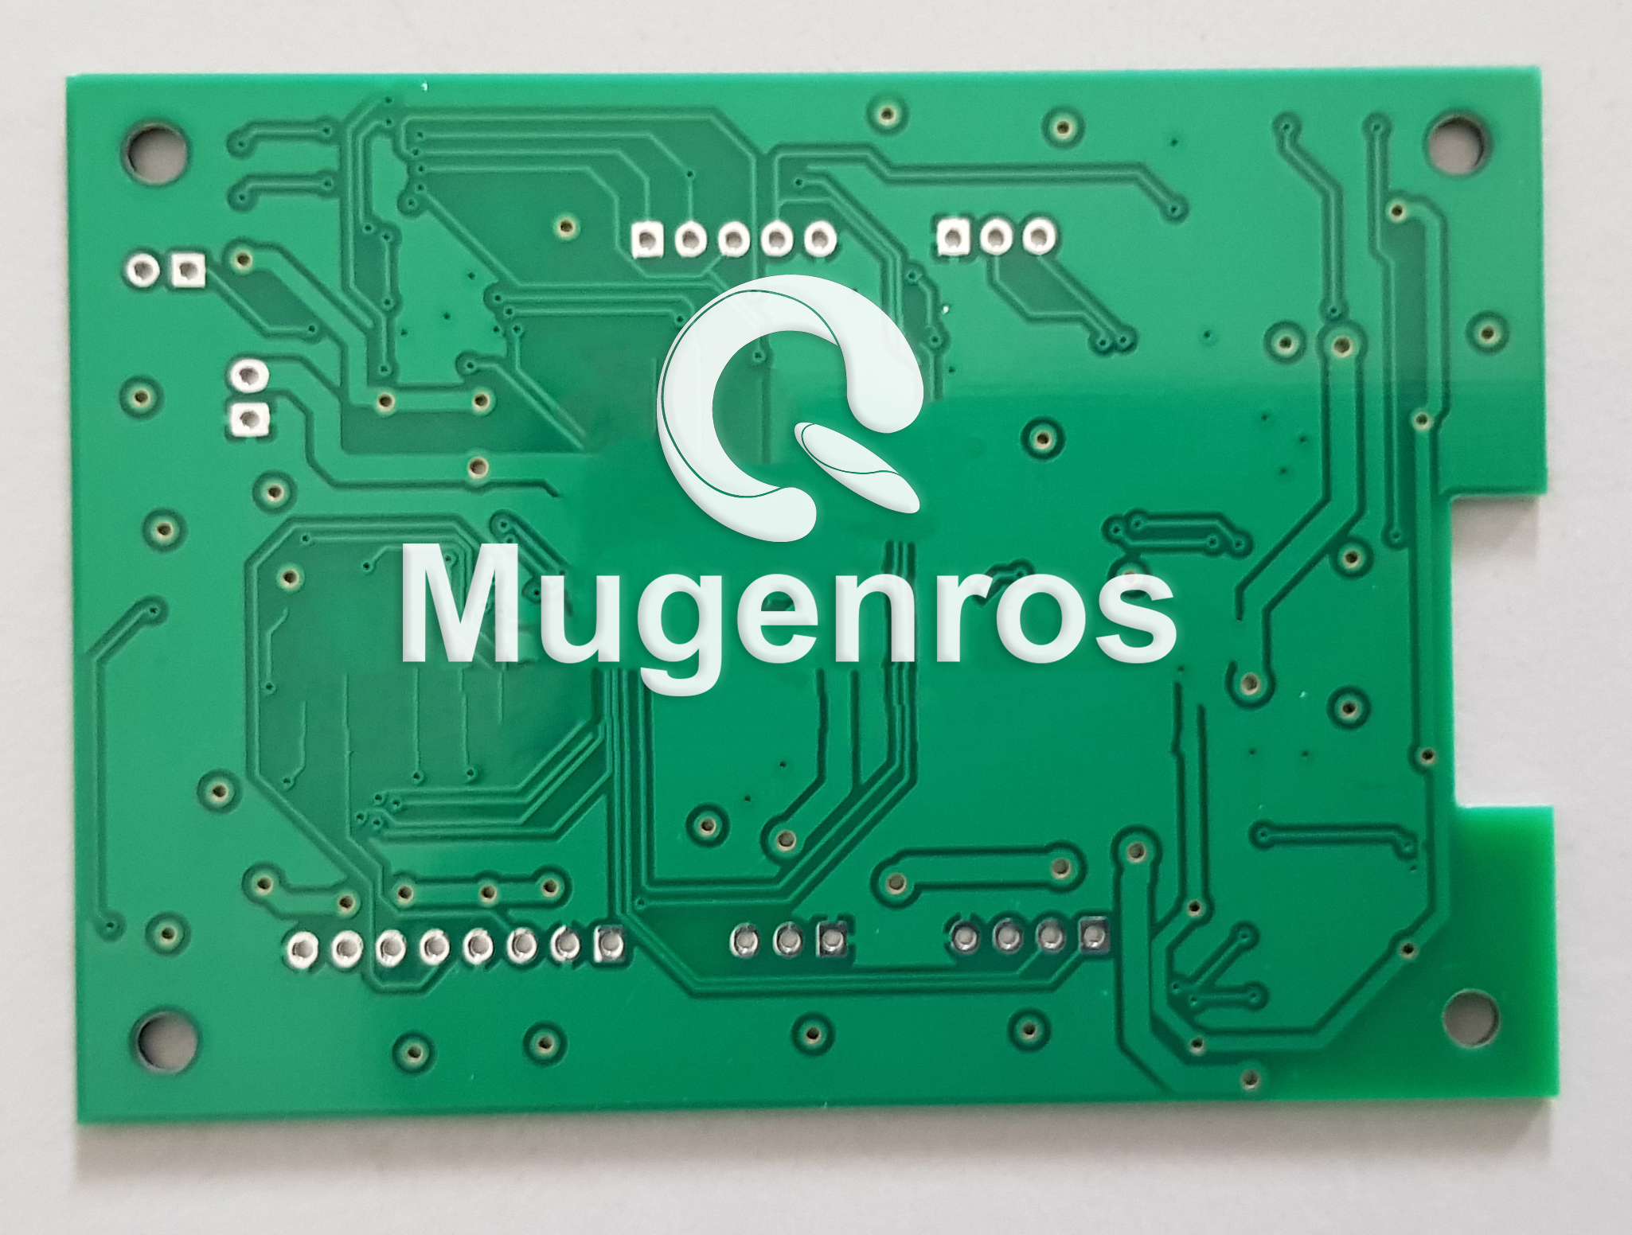
2.0 TECHNICAL SPECIFICATION
2.1 CPU - Master & Slave
a) Electronics
Controller
Coordinate
Battery
Communication
Display
Multi Particle Detector
Carbon Dioxide Detector
Gas Monitoring System
Project Design & Fabrication
Customized PCB embedded microcontroller
5V operating voltage
Fast cycle processing speed
Boot and wake up time less than 0.5 second
Centralized processing system
Support lipo battery BMS

Slide 5
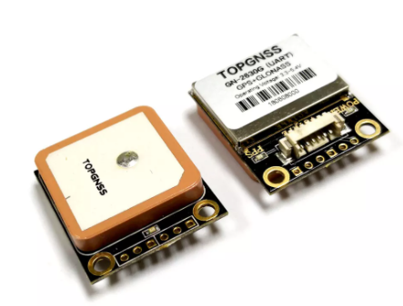
2.0 TECHNICAL SPECIFICATION
2.2 Coordinate Sensor
a) Electronics
Controller
Coordinate
Battery
Communication
Display
Multi Particle Detector
Carbon Dioxide Detector
Gas Monitoring System
Project Design & Fabrication
GNSS multi-mode design, support GPS+GLONASS and GPS+
5V operating voltage
Current consumption: max. 50mA
Cold start in ca. 26 seconds
Positioning accuracy: 2.5 m CEP (Circular Error Probable)

Slide 6
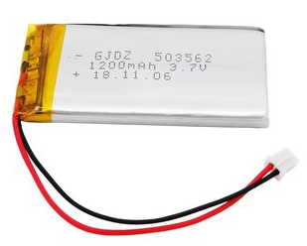
2.0 TECHNICAL SPECIFICATION
2.3 Battery
a) Electronics
Controller
Coordinate
Battery
Communication
Display
Multi Particle Detector
Carbon Dioxide Detector
Gas Monitoring System
Project Design & Fabrication
LifePO4 Battery
3.7V 3000mAH
12,600 mWH
Minimum voltage: 3.8V
Maximum voltage: 4.2V

Slide 7
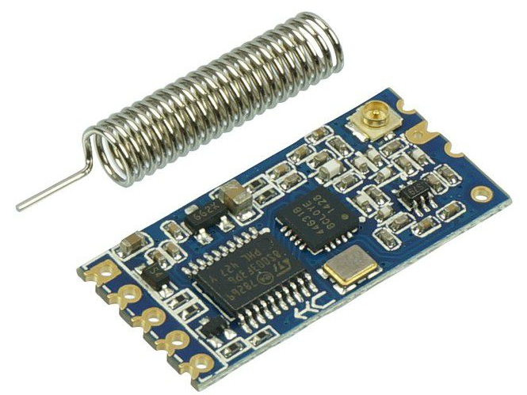
2.0 TECHNICAL SPECIFICATION
2.4 Communication
a) Electronics
Controller
Coordinate
Battery
Communication
Display
Multi Particle Detector
Carbon Dioxide Detector
Gas Monitoring System
Project Design & Fabrication
LoRa Communication
Long Range Radio Frequency type communication
Model Number: RF-UART-433-1KM
Working Frequency: 433.4-473.0MHz
Communication Distance: 1000m
Power Supply Voltage: 3.2-5.5V DC

Slide 8
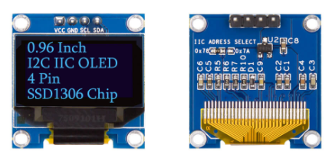
2.0 TECHNICAL SPECIFICATION
2.5 Display
a) Electronics
Controller
Coordinate
Battery
Communication
Display
Multi Particle Detector
Carbon Dioxide Detector
Gas Monitoring System
Project Design & Fabrication
OLED type
Resolution: 128 x 64 pixels
Display Area: 0.96 inch diagonal
Supply Voltage (Vcc): 3.3V
Dimension (Overall Module): 27.7 x 27.2 x 3.8 mm
Dimension (OLED Panel only): 26.7 x 19.3 x 1.7 mm

Slide 9
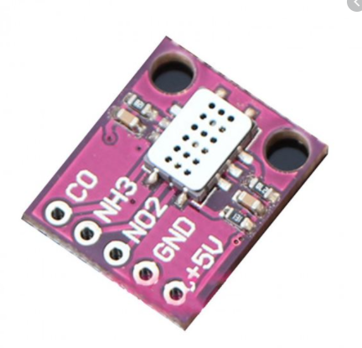
2.0 TECHNICAL SPECIFICATION
2.6 Multi Particle Detector
a) Electronics
Controller
Coordinate
Battery
Communication
Display
Multi Particle Detector
Carbon Dioxide Detector
Gas Monitoring System
Project Design & Fabrication
MICS-6814 Air quality CO VOC NH3 Nitrogen oxides Gas sensor 1000ppm
Supply voltage: DC4.9V-5.1V
Carbon monoxide CO 1-1000ppm
Nitrogen dioxide NO2 0.05-10ppm
Ammonia NH3 1-500ppm

Slide 10
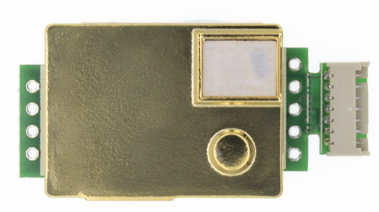
2.0 TECHNICAL SPECIFICATION
2.7 Carbon Dioxide Detector
a) Electronics
Controller
Coordinate
Battery
Communication
Display
Multi Particle Detector
Carbon Dioxide Detector
Gas Monitoring System
Project Design & Fabrication
MH-Z19 infrared co2 sensor
Built-in temperature compensation.
Support analog, PWM and serial output
Measurement range: 0-5000 parts per million (PPM)
Operating Voltage 4.5V to 5.5VDC
Preheat time: 3 minutes
Response Time <90s

Slide 11
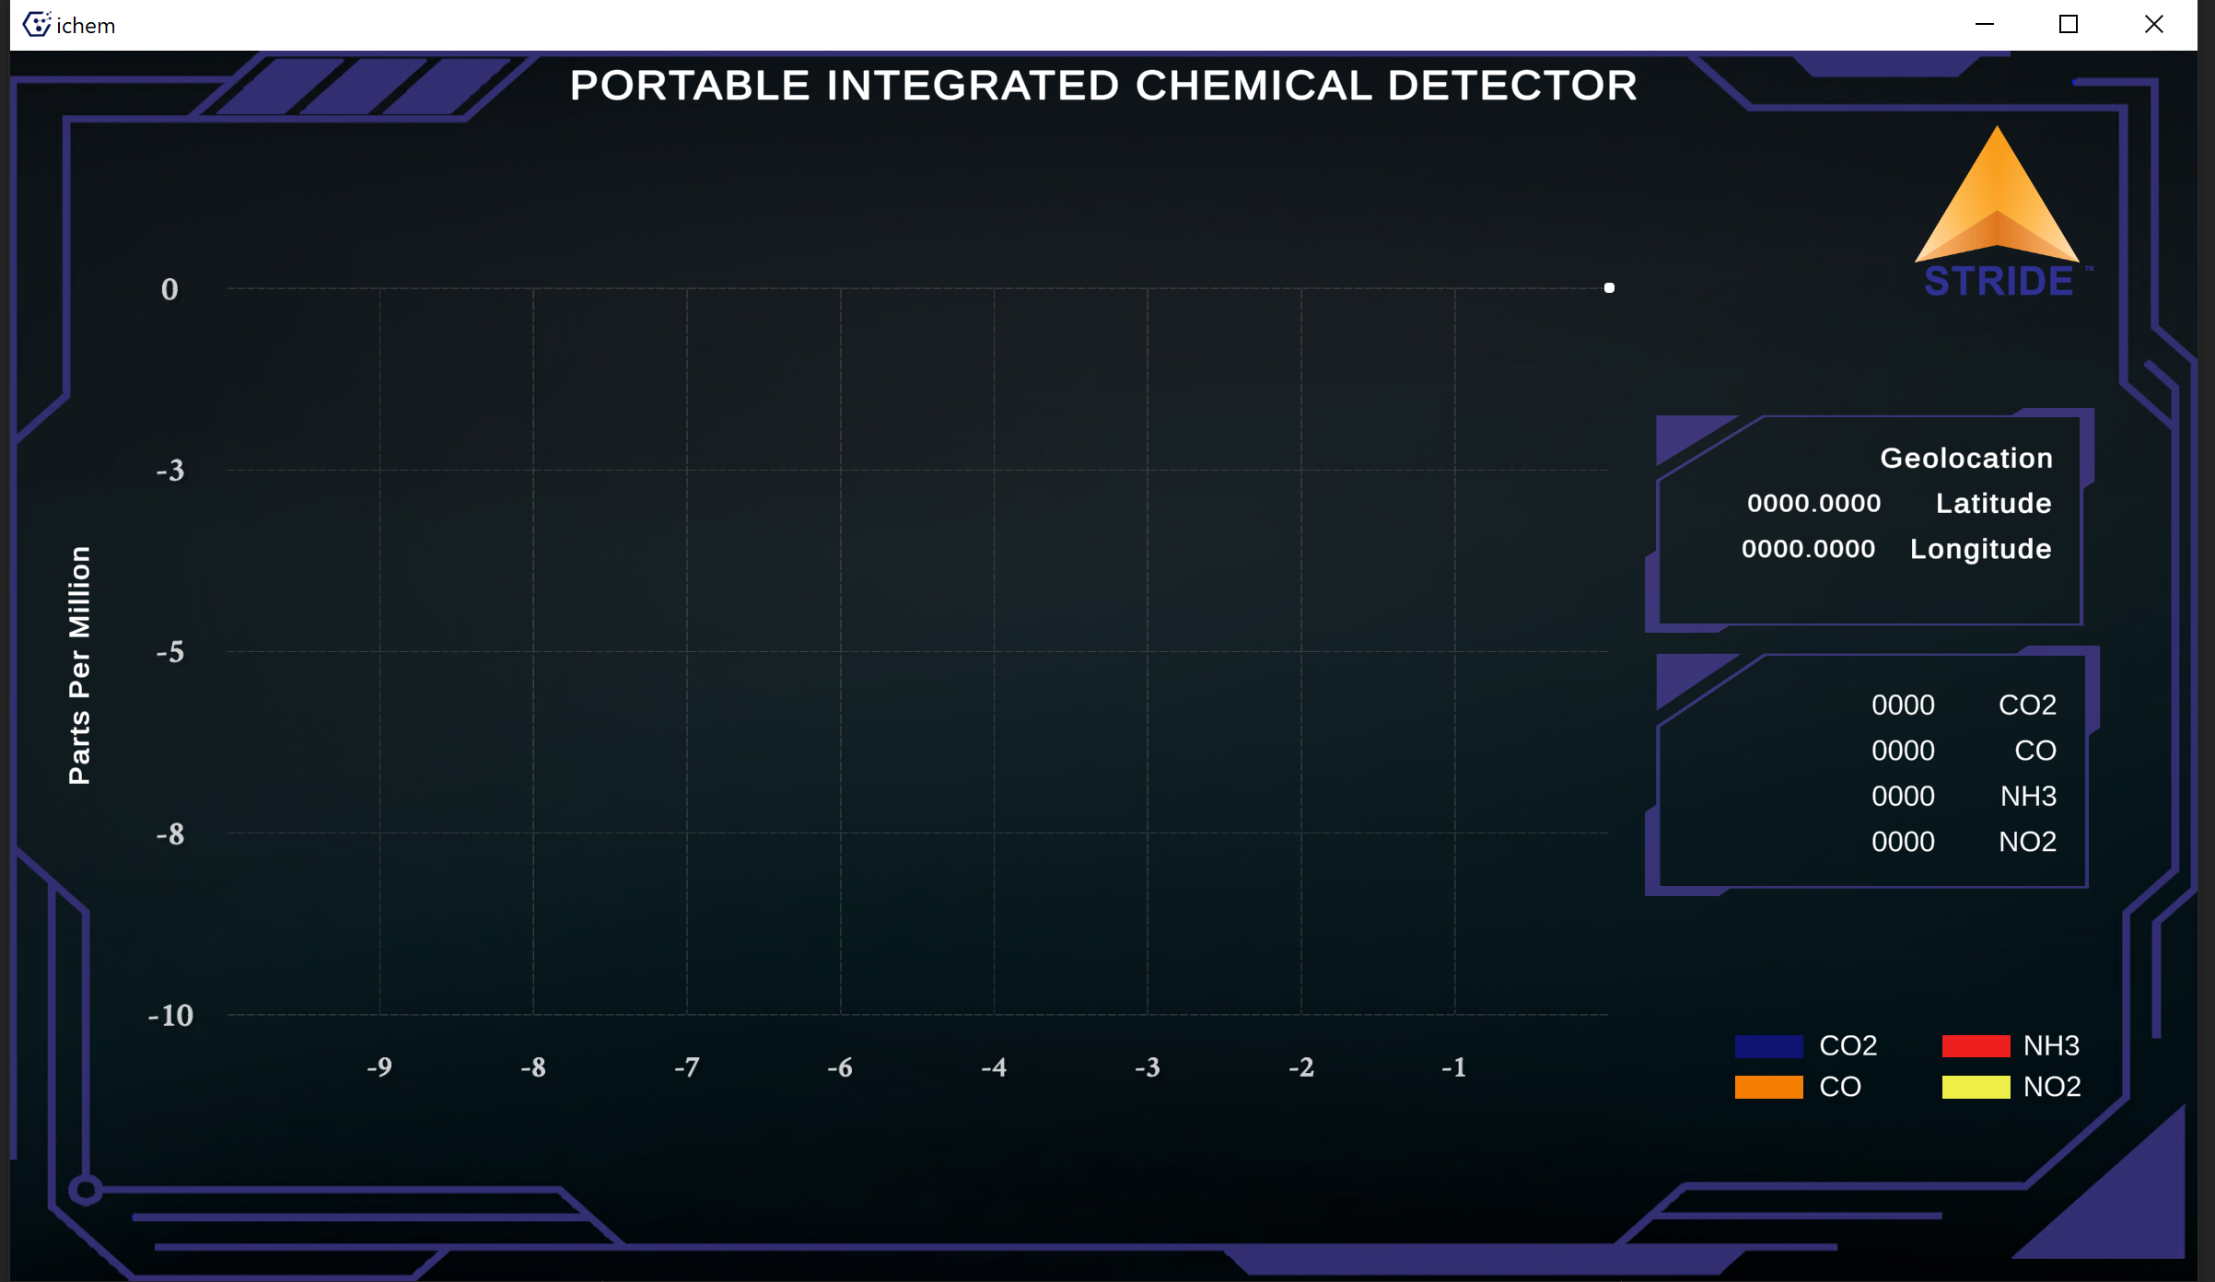
2.0 TECHNICAL SPECIFICATION
2.8 Gas Monitoring System
a) Electronics
Controller
Coordinate
Battery
Communication
Display
Multi Particle Detection
Carbon Dioxide Detection
Gas Monitoring System
Project Design & Fabrication
Memantau semua gas yang dikesan dilokasi
Mempamerkan lokasi GPS
Mengandungi fungsi untuk menyimpan data ke dalam format Excel

Slide 12
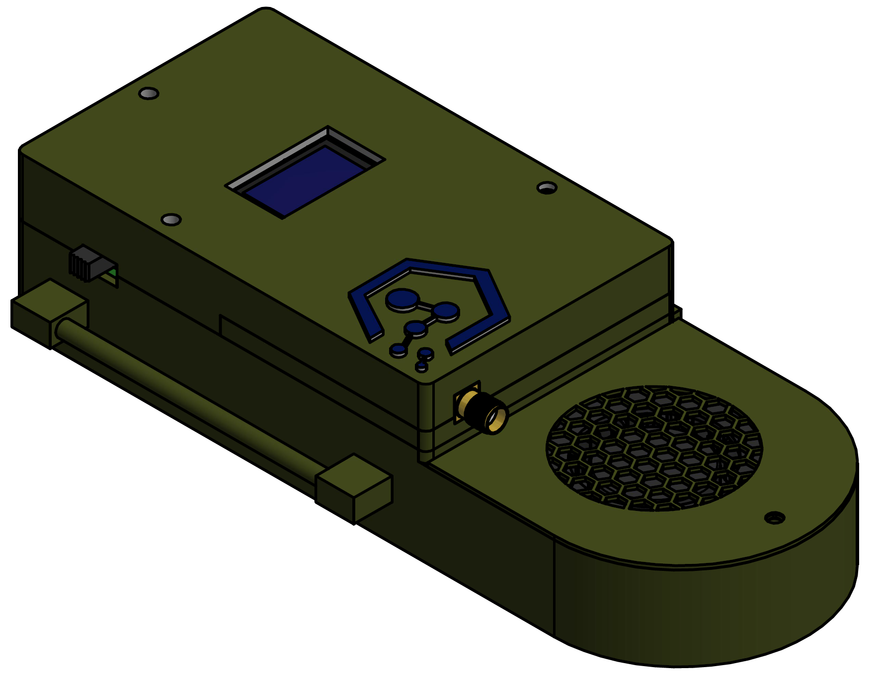
2.0 TECHNICAL SPECIFICATION
2.8 Project Design & Fabrication
a) Electronics
Controller
Coordinate
Battery
Communication
Display
Multi Particle Detection
Carbon Dioxide Detection
Gas Monitoring System
Project Design & Fabrication
Merekabentuk kotak simpanan yang khas
Merekabentuk saluran udara yang khas untuk kegunaan sensor
Menggunakan Teknik 3D print

Slide 13
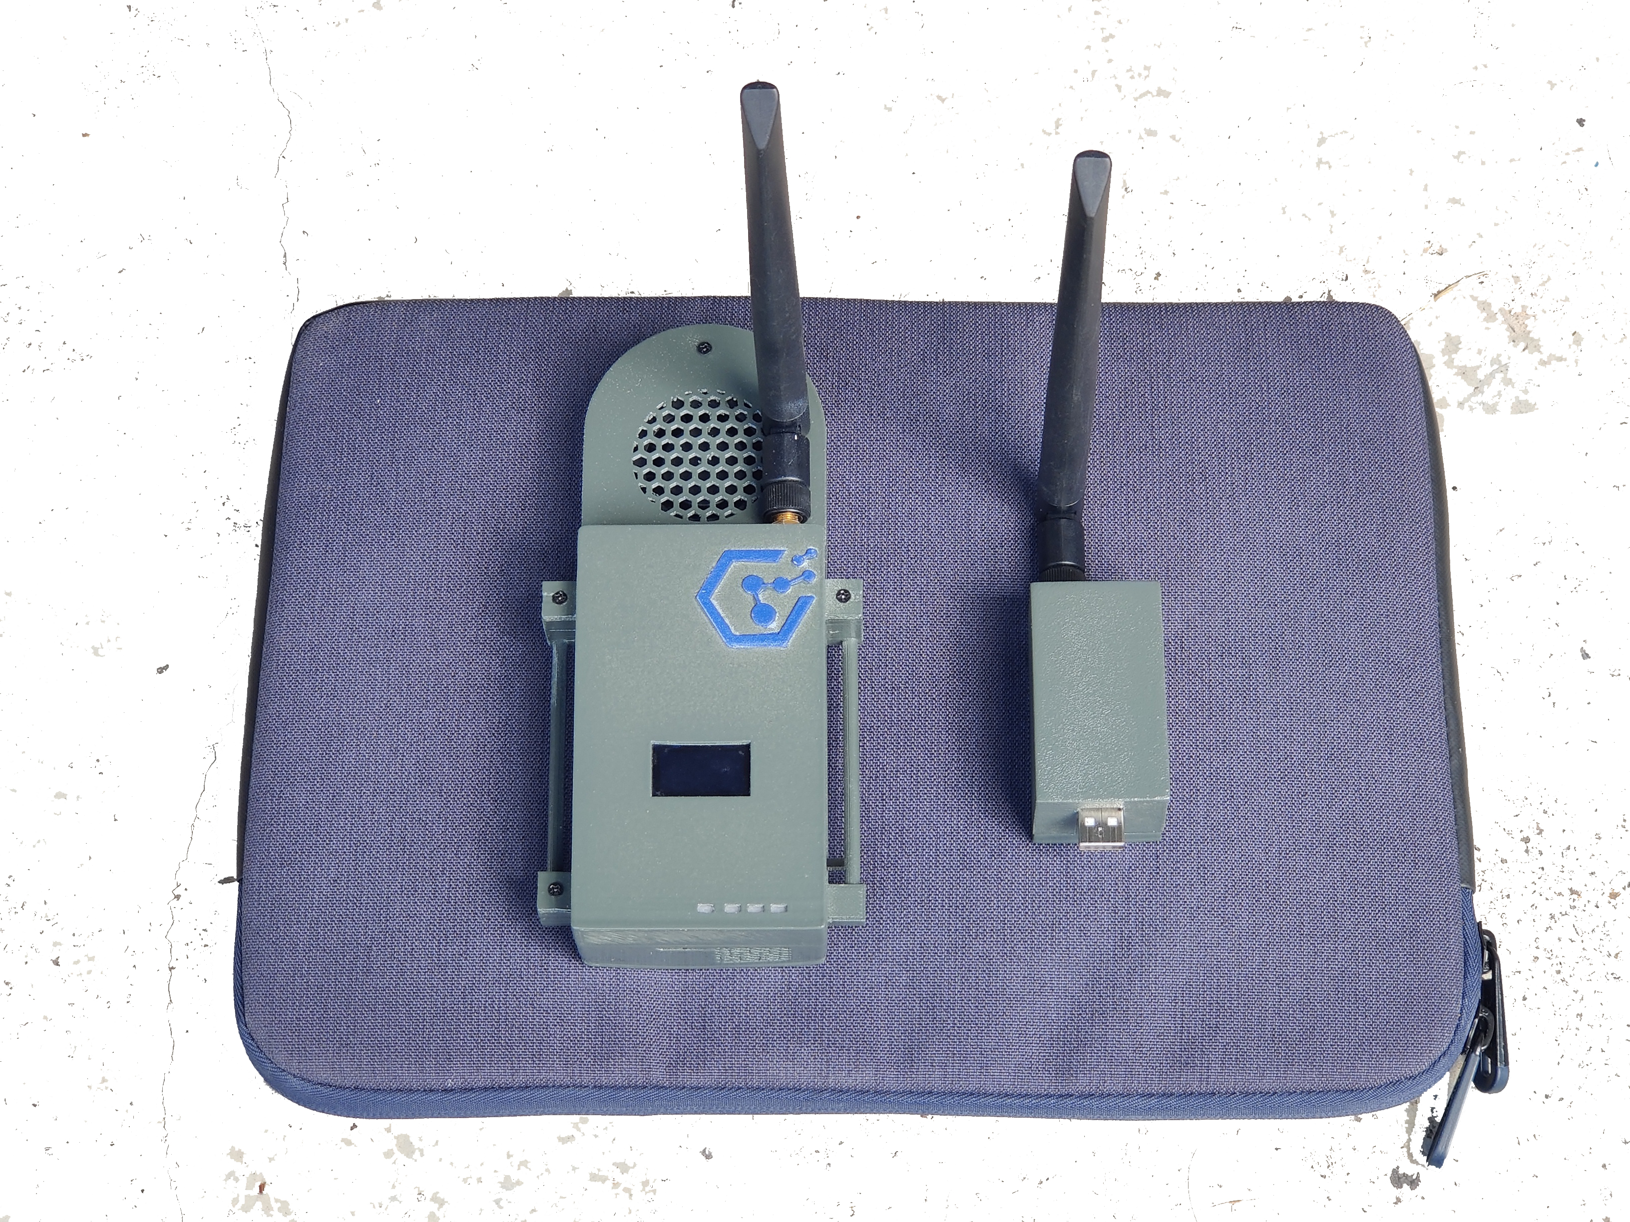
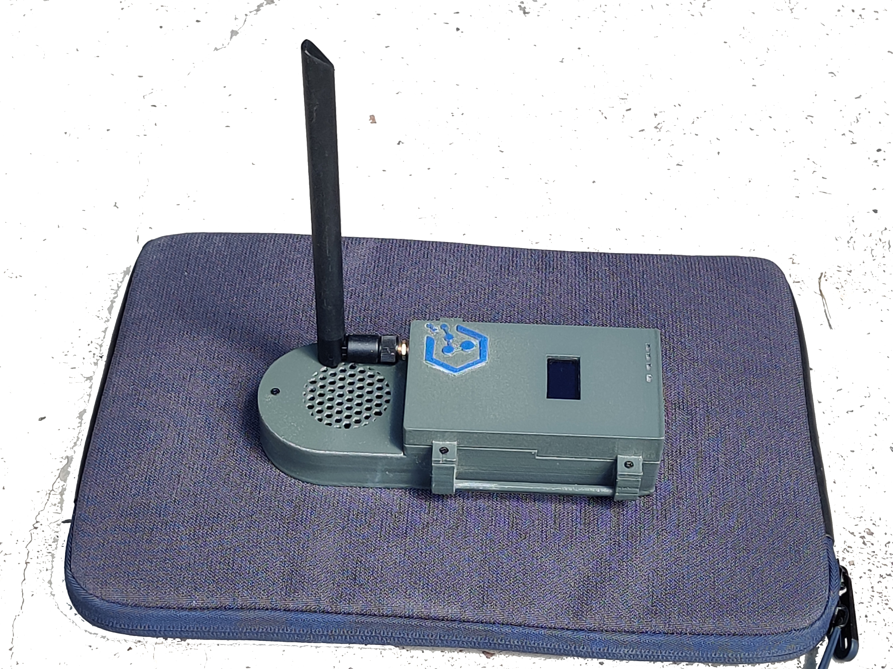
3.0 Prototype

Slide 14
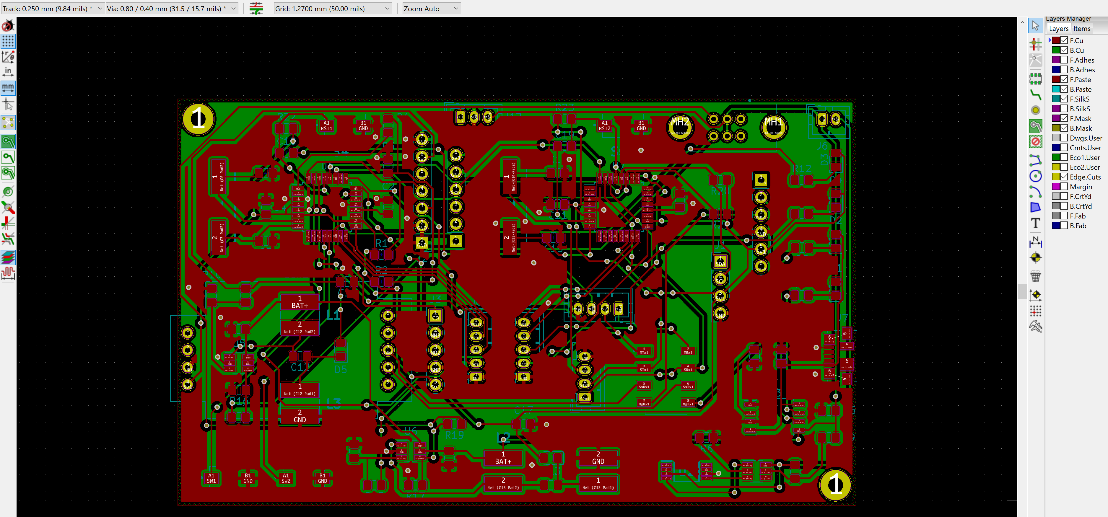
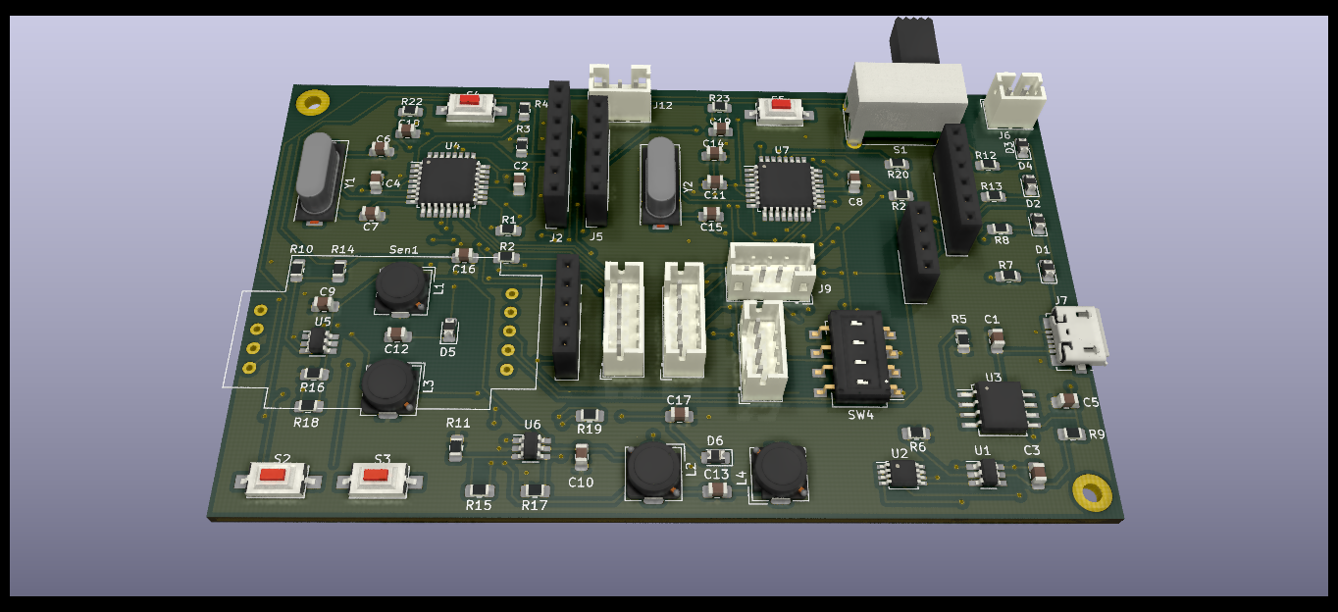
4.0 ELECTRONIC

